Slide 1
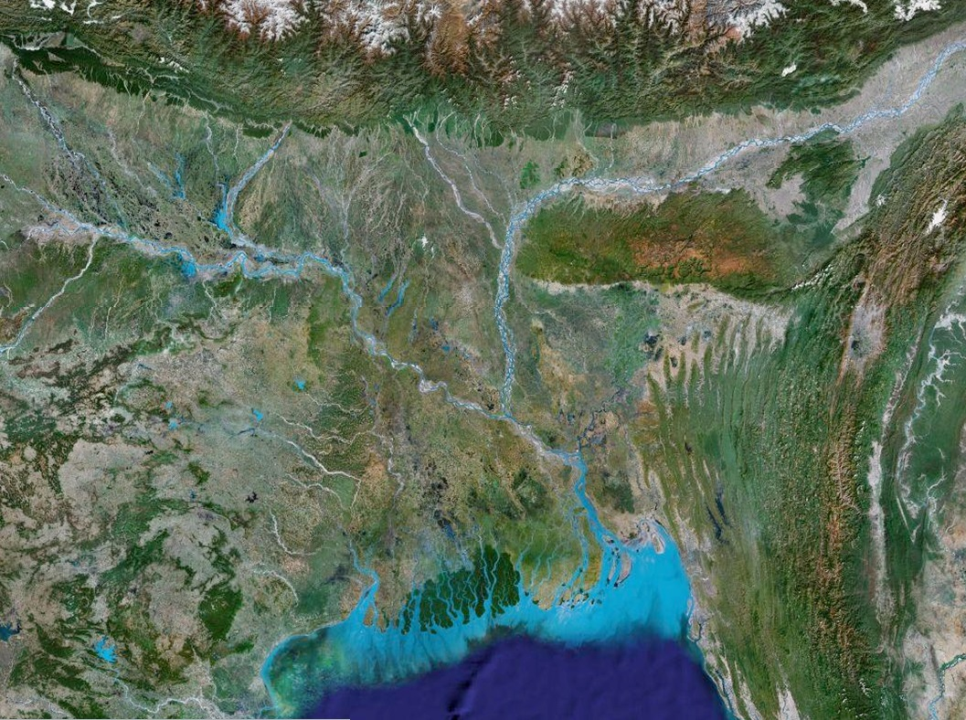




Satellite Rainfall Retrieval
Over Coastal Zones
Deltas in Times of Climate Change II
Rotterdam. September 26, 2014
Efi Foufoula-Georgiou
University of Minnesota
Department of Civil, Environmental and Geo- Engineering

Slide 2
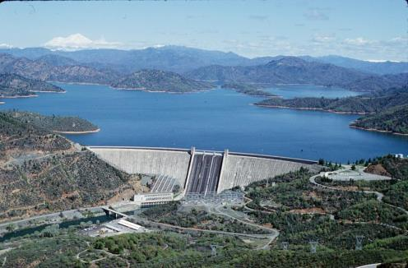

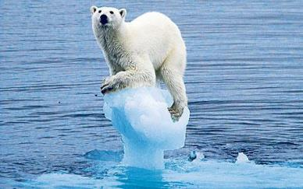
Discharge / Sediment
Local
activities
Ocean waves/tides

Slide 3
Discharge / Sediment
Local
activities
Sea level / Subsidence

Slide 4
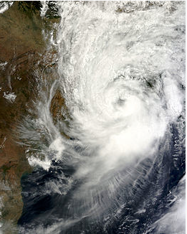
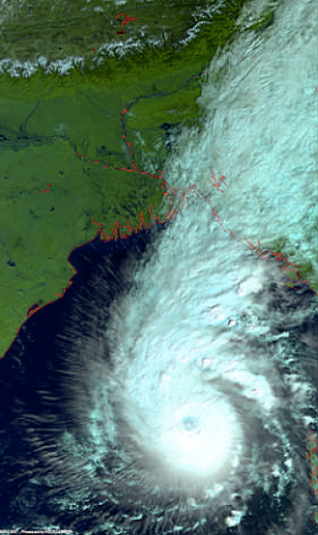
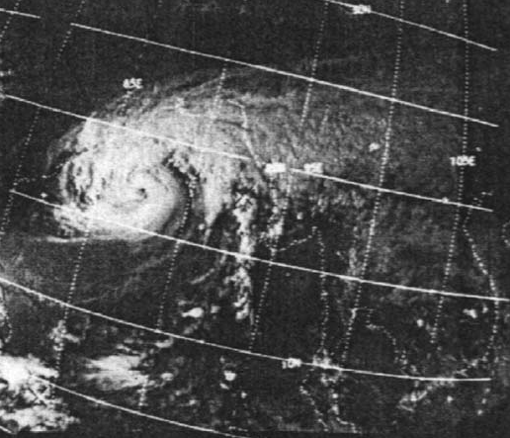
Cyclone Aila,May 2009
Cyclone Sidr, Nov 14, 2007
Cyclone Bhola, Nov 1970
Limited ground-based observations of rain
Very flat terrain and increasing human alterations
Tropical cyclones causing deaths and extensive damage

Slide 5
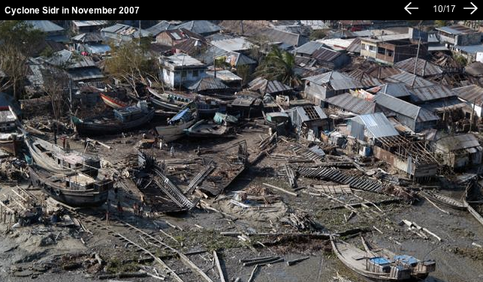

Slide 6
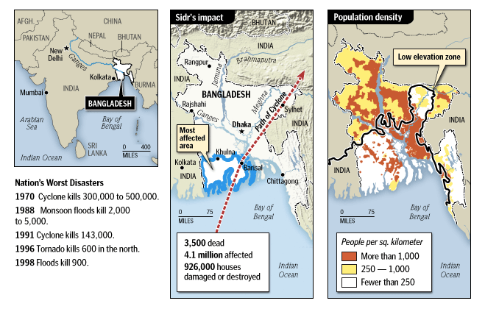
A snapshot of worst flood disasters in Bangladesh
http://freshclick.wordpress.com/2009/03/27/causes-of-the-flooding-in-bangladesh/

Slide 7
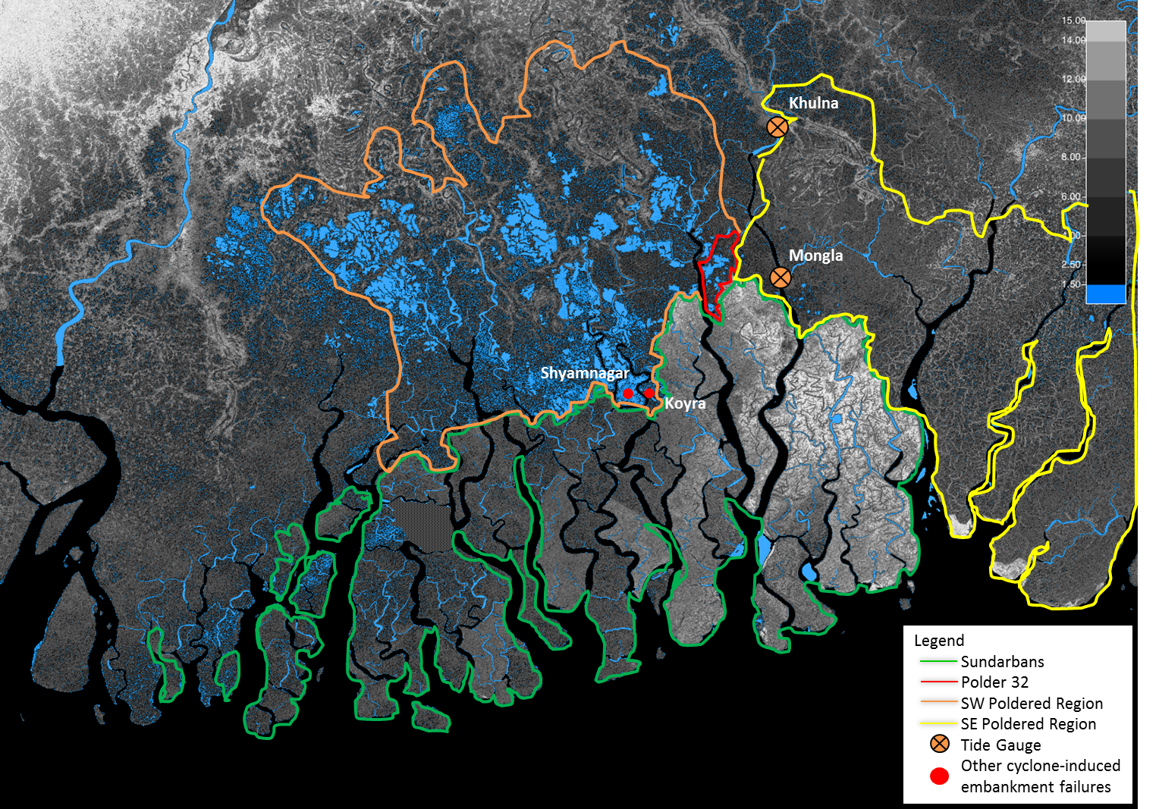
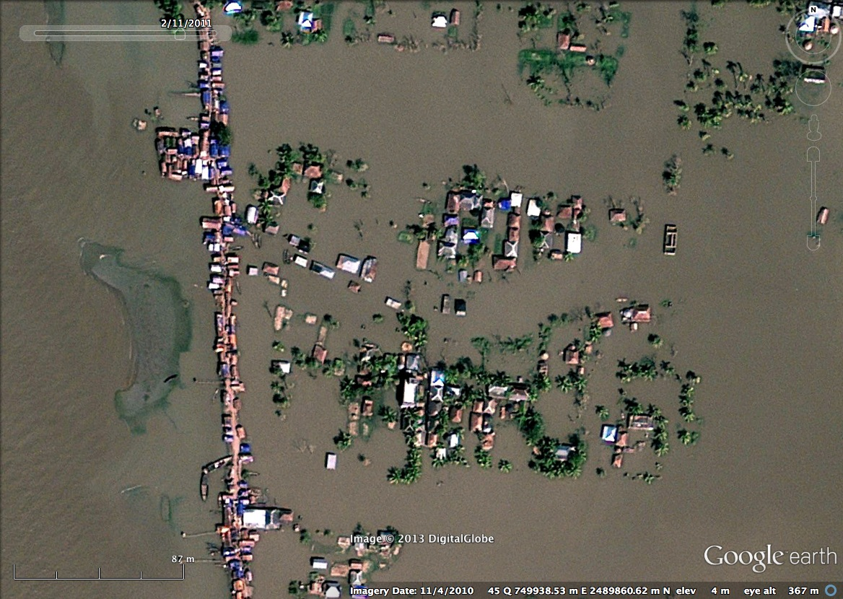
Human amplified effects of tropical storms in low-lying delta settings
Tidal inundated island 18 months after Cyclone Aila

Slide 8
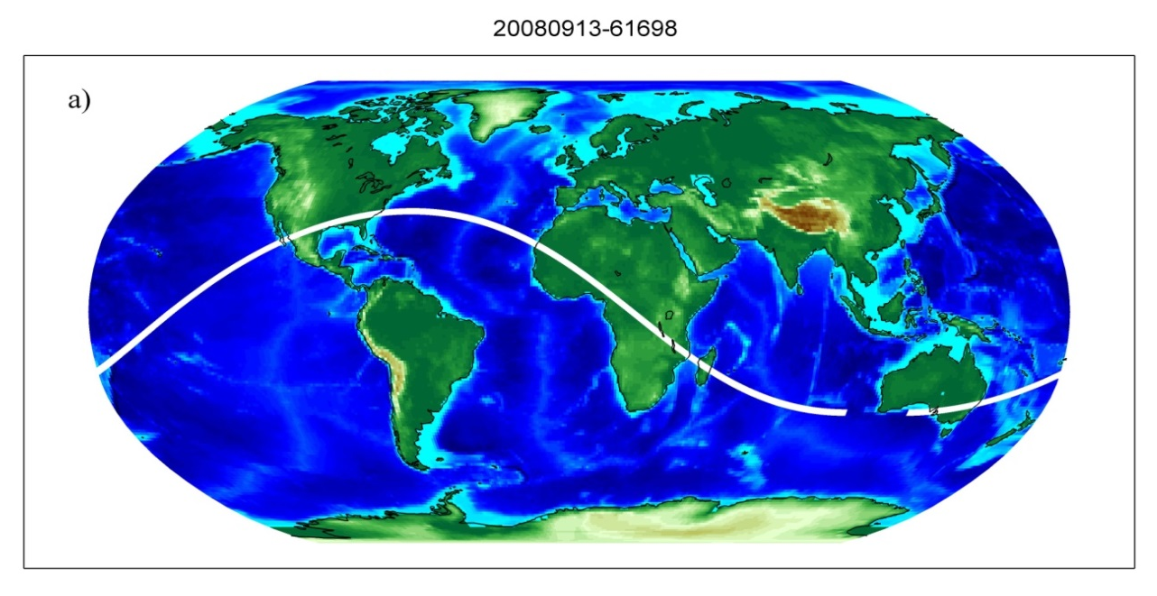
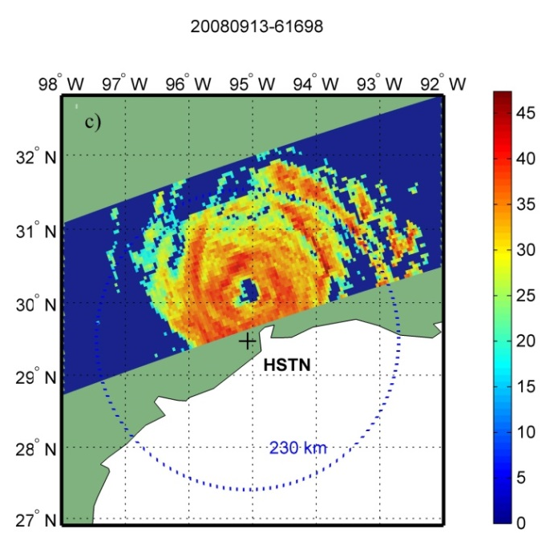
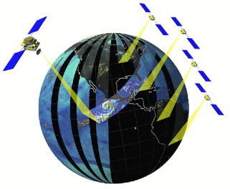
Estimating Precipitation from Space: from TRMM to GPM
TRMM
(1997 -)
PR
GPM (2014 -)
From TRMM to GPM:
New opportunities &
new challenges
in retrieval, fusion,
and downscaling
of precipitation

Slide 9

GPM: A New Era of Global Precipitation Observations
GPM Core Observatory: Launched on February 27, 2014 from JAXA’s Tanegashima Space Center
on a Japanese H-IIA rocket

Slide 10
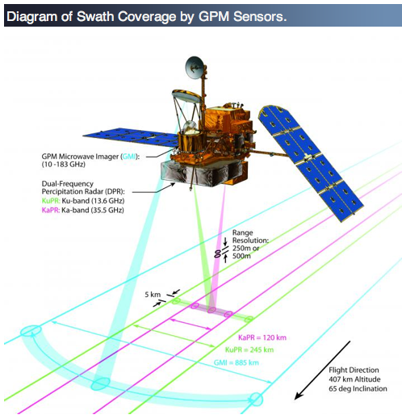

Spaceborne Rainfall: form TRMM to GPM
DPR:
125 and 245 Km swaths
Ka-band: 35.5 GHz
Ku-band: 13.6 GHz
GMI:
885 Km swath
13 channels 10 -183 GHz

Slide 11
Rainfall Estimation Problems
Downscaling: Enhancing the resolution of a measured or modeled field
Data Fusion: Produce an improved estimate of a field from a suite of noisy observations at different scales
Data Assimilation: Estimate the initial conditions in a predictive model consistent with the available noisy observations and model dynamics
Retrieval: Estimate rainfall from indirect noisy and lower resolution observations of brightness temperature
Increasing challenges over heterogeneous surfaces and land-water interface
Emphasis on preserving multi-scale features, sharp fronts, and extremes

Slide 12
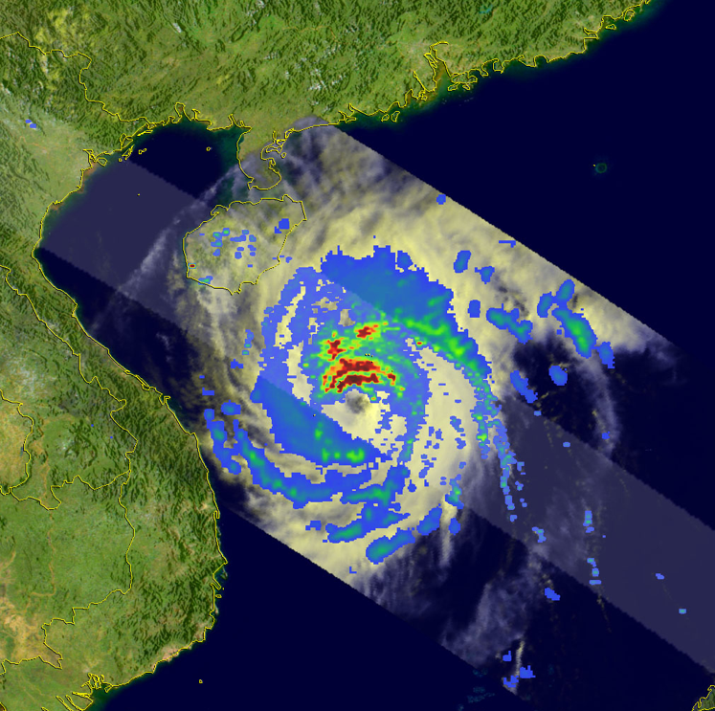
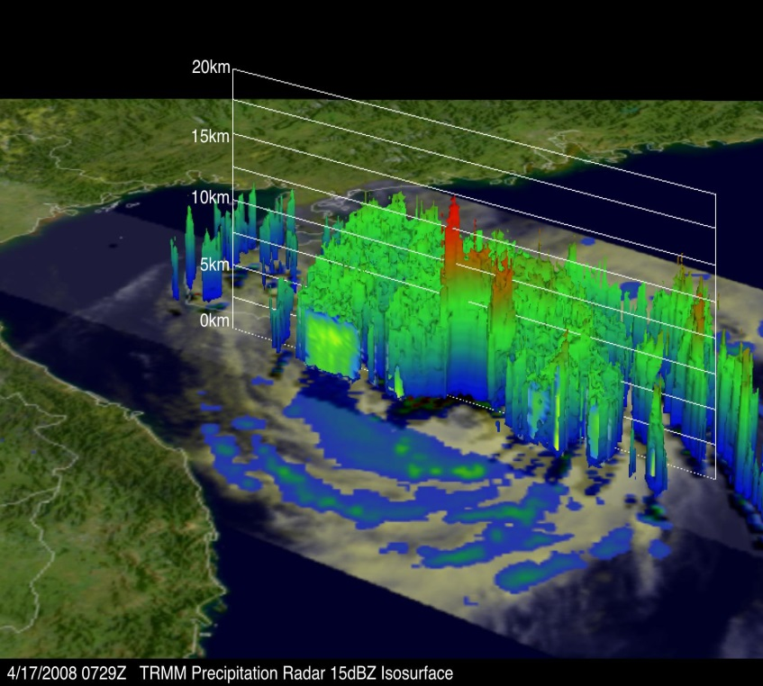
Spatial Structure of Rainfall
TRMM PR and TMI
Typhoon Neoguri, Western Pacific, April, 2008, http://trmm.gsfc.nasa.gov

Slide 13
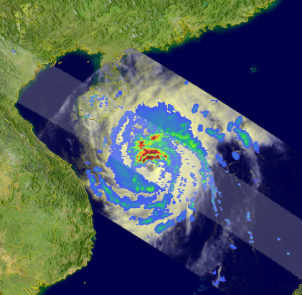
Non-Gaussian PDF in the Gradient Domain
zeroes
Gaussian
PDF of gradients >>
Extreme gradients
Generalized Gaussian Density (GGD)
(α=1 Laplace)
“Sparsity”

Slide 14
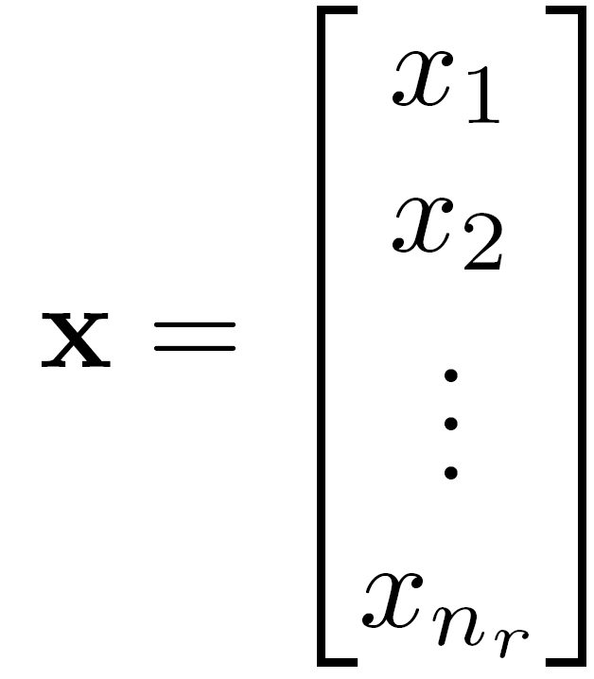
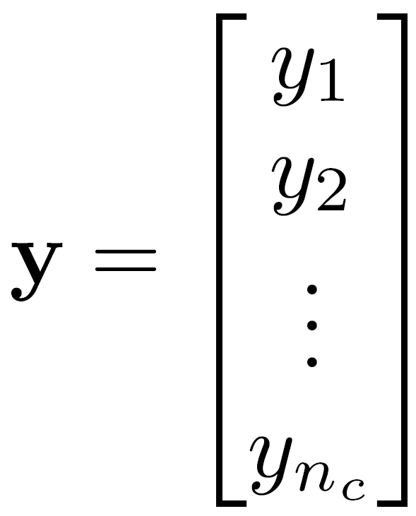
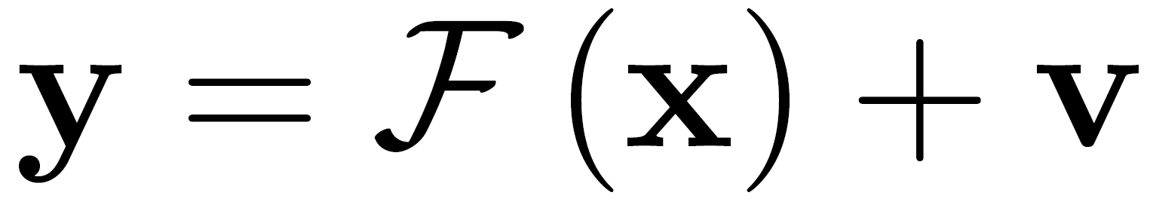

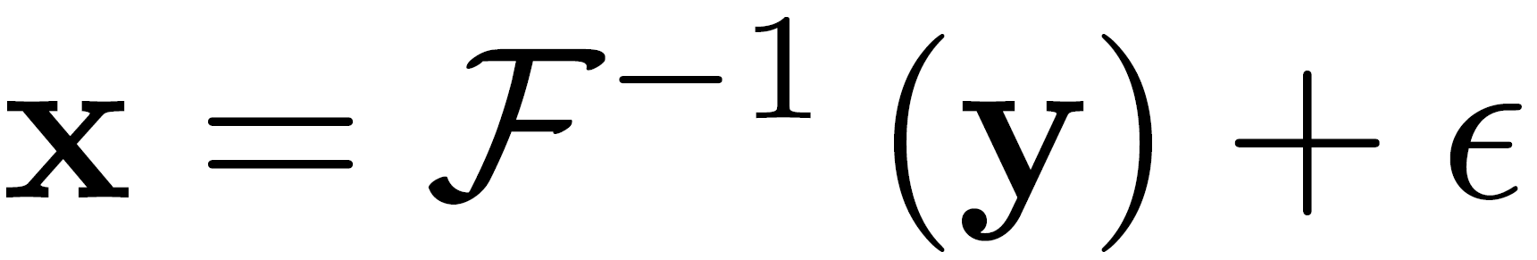
Passive Microwave Retrieval: an Inverse Problem
Physics
Radiation regime
Absorption
Emission
Scattering
Land-surf emissivity
….
Rain
Spectral Radiances
Retrieval problem:
New ideas:
Preserve sharp features in estimation by choosing the proper prior
Learn patterns in a “smart way” from the data=> key to retrieval
Explore Compressive sensing methodologies to retrieve from fewer observations
When physics get though, advanced mathematical analysis and estimation methods can add insight and improve Bayesian inversion
  Treat nature as a “physical laboratory” (acknowledge observational uncertainties)

Slide 15
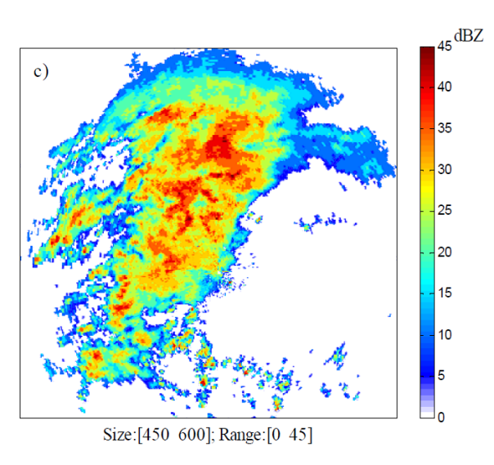
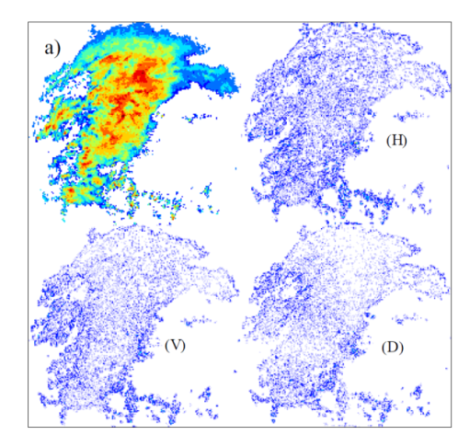
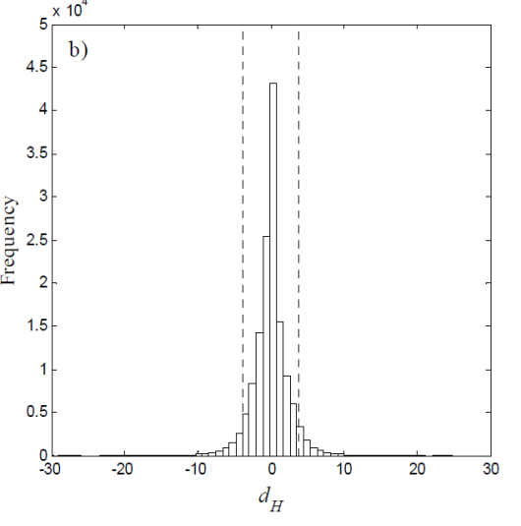
NEW IDEAS for GPM—1
1. Preserve unique features during estimation
-- Precipitation has an intermittent and multi-variable space-time structure ➔
when projected in a derivative domain it displays “sparsity”
Replace
80% by
zeroes
Wavelet Decomposition
PDF of Coefficients
Reconstructed image
-- Sparsity requires moving away from standard Least Squares (L2) estimation
paradigms and working with L1 norms (preserve a non-Gaussian prior)
-- Downscaling, Fusion, Variational Data Assimilation
Ebtehaj A.M., G.Lerman, E Foufoula-Geogiou, JGR-A, 2012
Ebtehaj, A.M. and E. Foufoula-Georgiou, WRR, 2013
Ebtehaj, A.M., M. Zupanski, G. Lerman, and E. Foufoula-Georgiou, Tellus A, 2014
Foufoula-Georgiou, E., A.M Ebtehaj, S. Zhang, A. Hou, Surveys in Geophysics, 2014

Slide 16
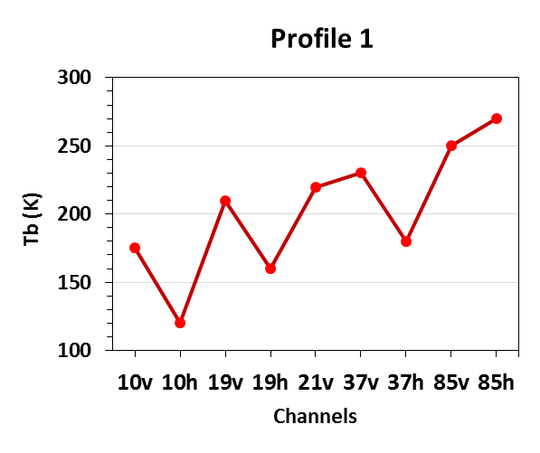
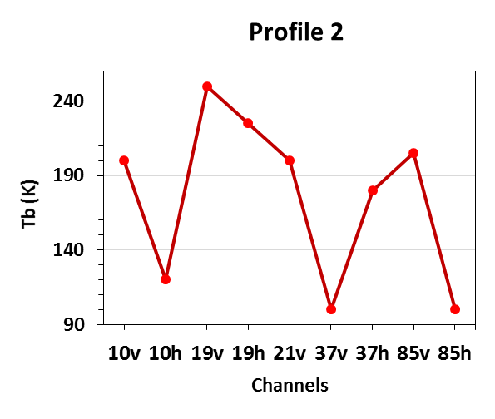
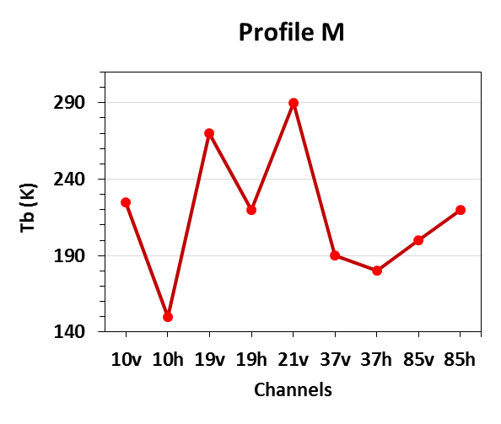
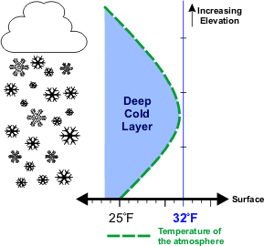
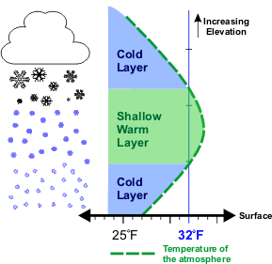
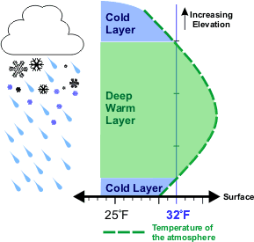
NEW IDEAS for GPM—2
2. Learn patterns from data for retrieval
  Spectral BT
  Rainfall Profiles
ShARP: Shrunken Locally Linear Embedding for Passive Retrieval
of Precipitation
9-dim space
(each point is a
BT vector)
Manifold of BT
n-dim space
(each point is a Z,
surf R vector)
Manifold of R
“Manifold learning”
Advanced estimation
Database
  Spectral BT
x₁
x₂
x_{M}
  Rainfall Profiles

Slide 17
CONCEPTS AND RESULTS ON RETRIEVAL

Slide 18
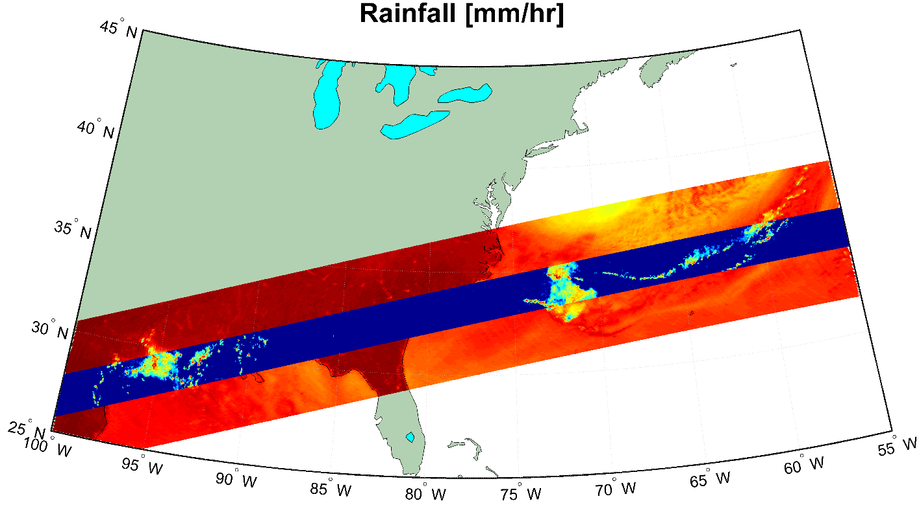

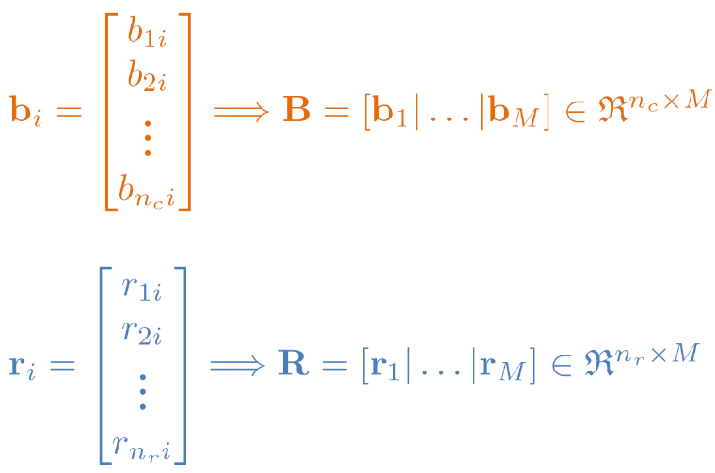




Overlapping measurements of TMI and PR
Rainfall and Radiometric Observations:
  Dictionaries
[kelvin]
Built by 25x10⁶ randomly chosen pixels of spectral observations + rainfall
[kelvin]
[mm/hr]
[mm/hr]

Slide 19






ShARP: Locally linear embedding for rainfall retrieval
A New Algorithm (concept):
  Concept of the locally linear embedding (supervised NL manifold learning):
radiometer
radar
raining
non-raining
  Search for the K-nearest neighbors to detect raining signatures
  Estimate the representation coefficients and thus the rainfall profile
Saul and Roweis, Science, 2000

Slide 20
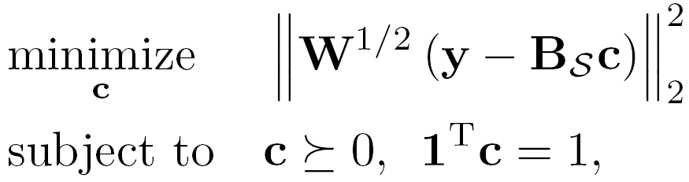
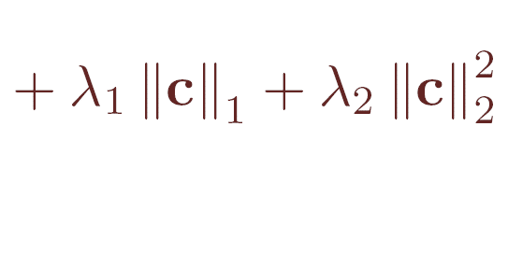



ShARP: Algorithmic sketch
Shrunken Locally Linear Embedding Algorithm for Precipitation Retrieval
  Detection step:
    K-nearest neighborhood search + a probabilistic voting rule for rain/no-rain
  Estimation Step:
    Estimation of the representation coefficients
L1-L2 regularization for stability and reduced estimation error
    Rainfall estimates

Slide 21


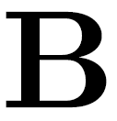
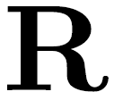
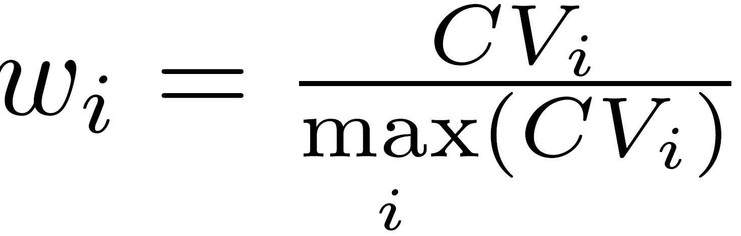
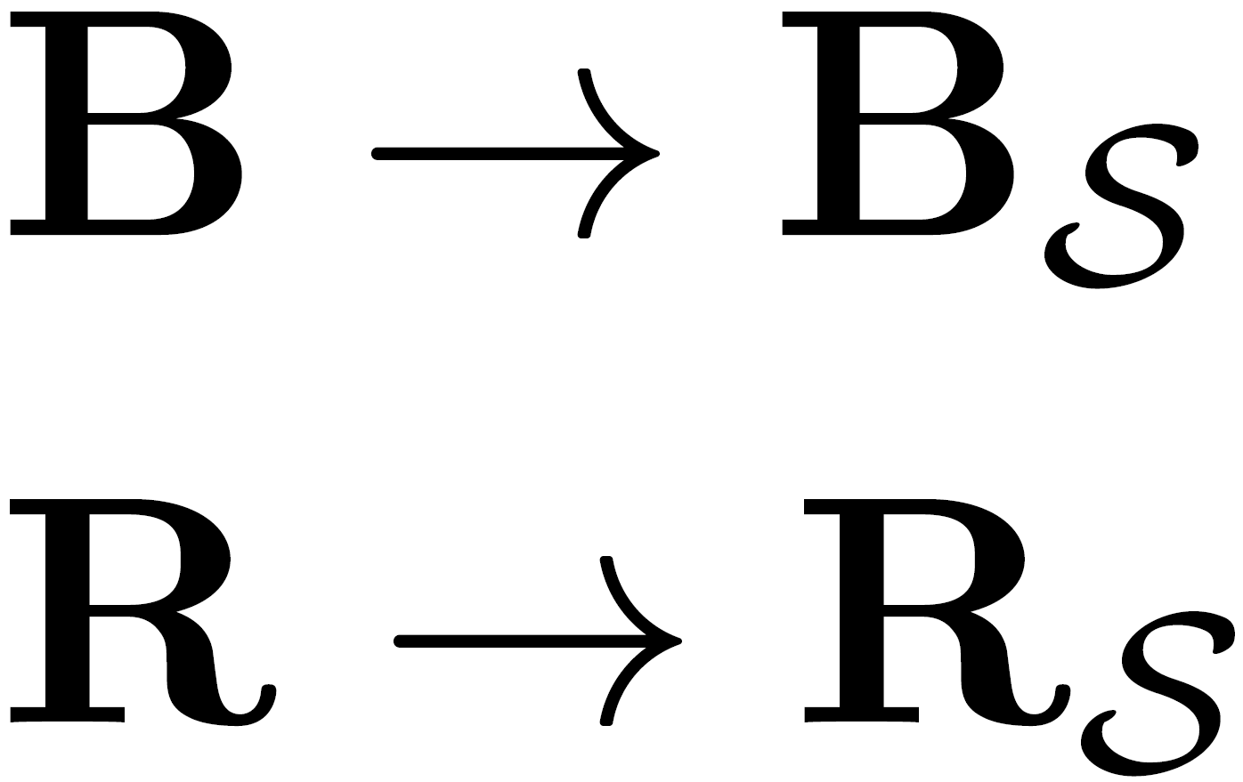
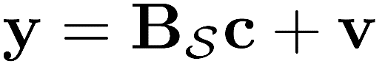
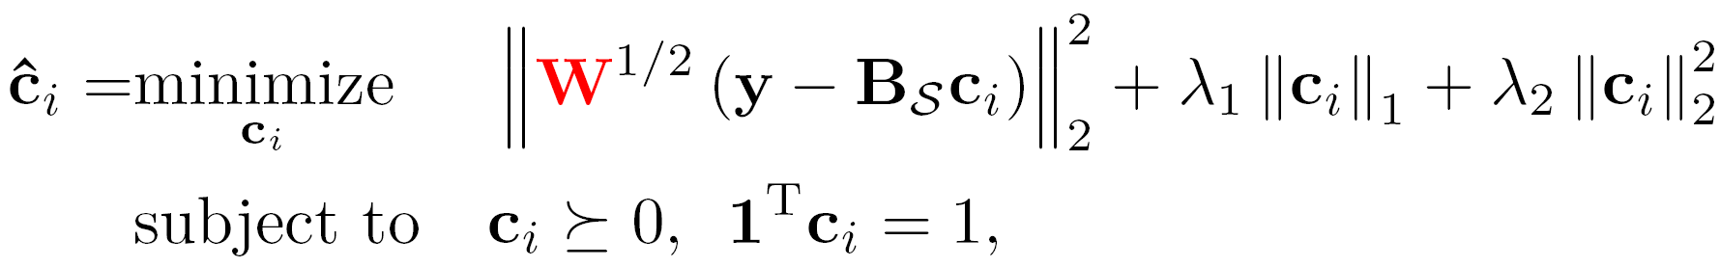
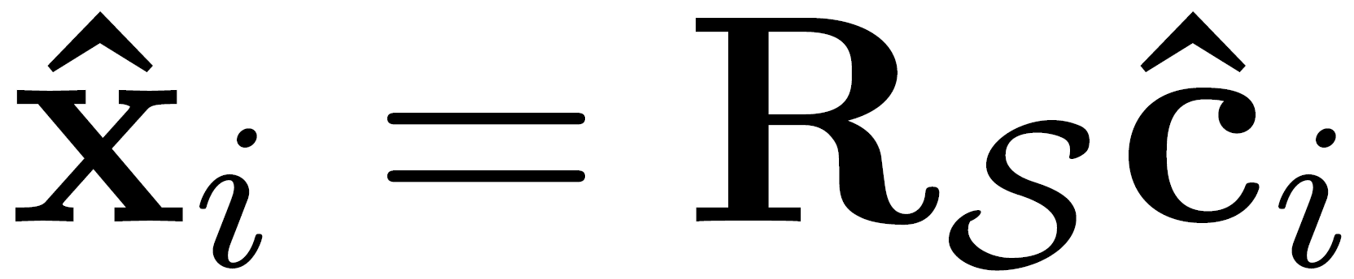
ShARP methodology
From: coincidental TMI, PR Obs.
Spectral Radiance Dictionary:
&
Precipitation Dictionary:
Prob. of voting
Channel weights
Detection Step:
Find K-nearest neighbors of in (sub-dictionaries)
Determine corresponding k-nn in
Determine if raining/non-raining on surface
Estimation Step:
Estimate representation coefficients of in using a locally linear model :
Estimate rainfall :
Important Note:

Slide 22
Estimation of representation coefficients in ShARP
Combined L1-L2 estimation
Some representation coefficients are very large and some very small (shrinkage due to L1 regularization chooses the most important neighbors)
The L2 regularization stabilizes the inversion for efficient and stable solution

Slide 23
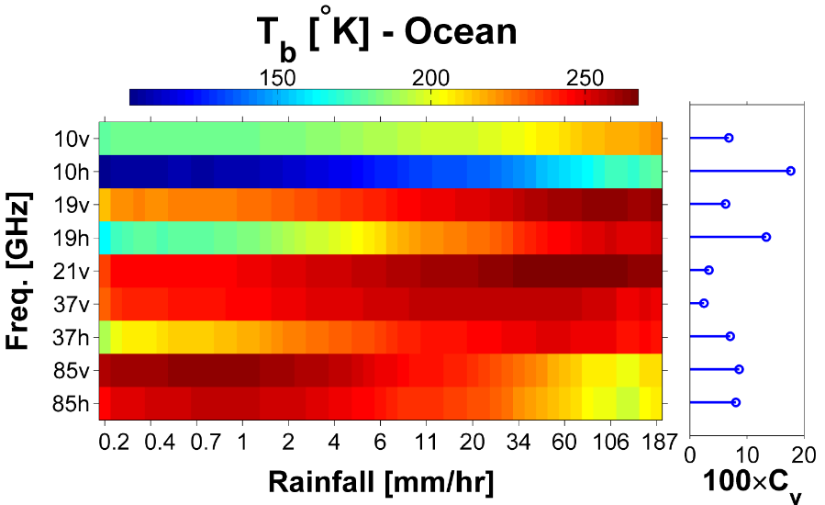
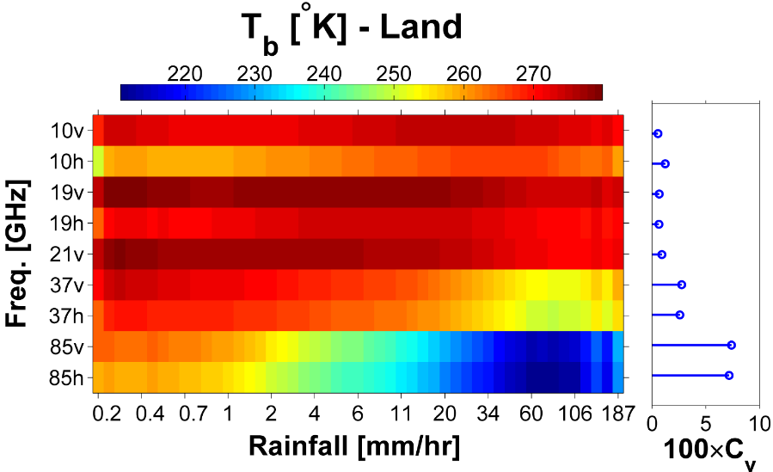
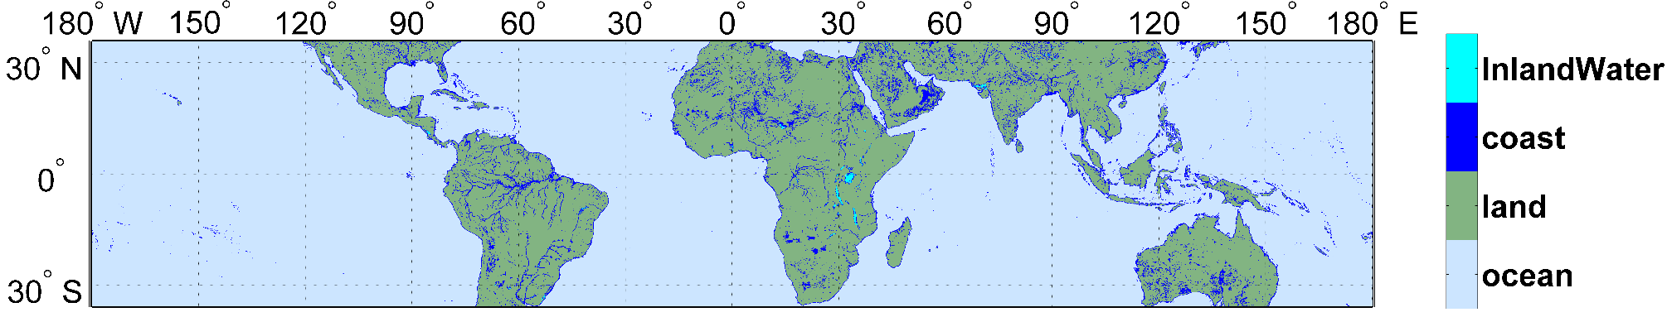
ShARP spectral weights (W) and land surfaces
Spectral weights denote relative importance of each channel

Slide 24
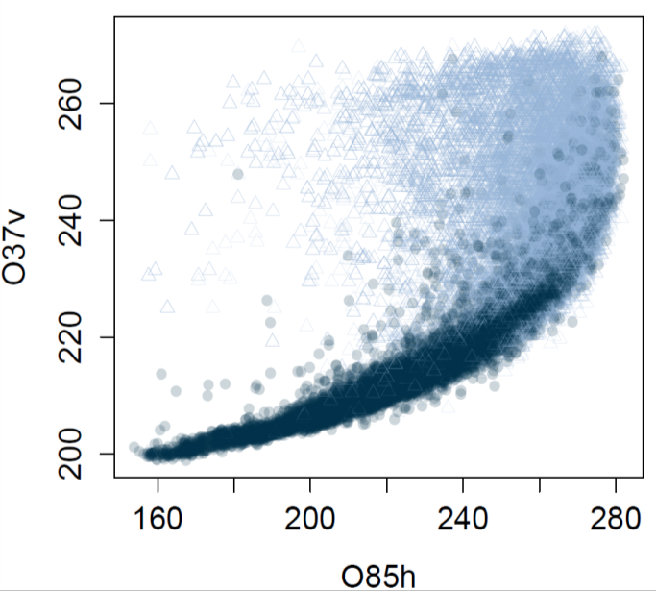
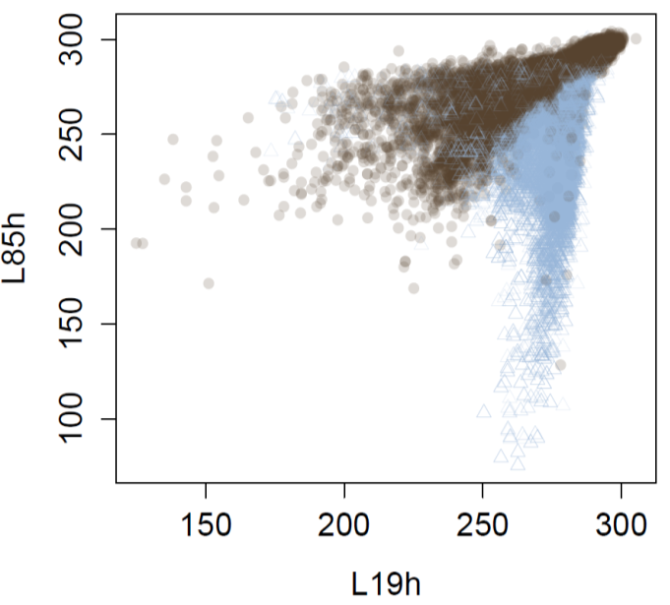
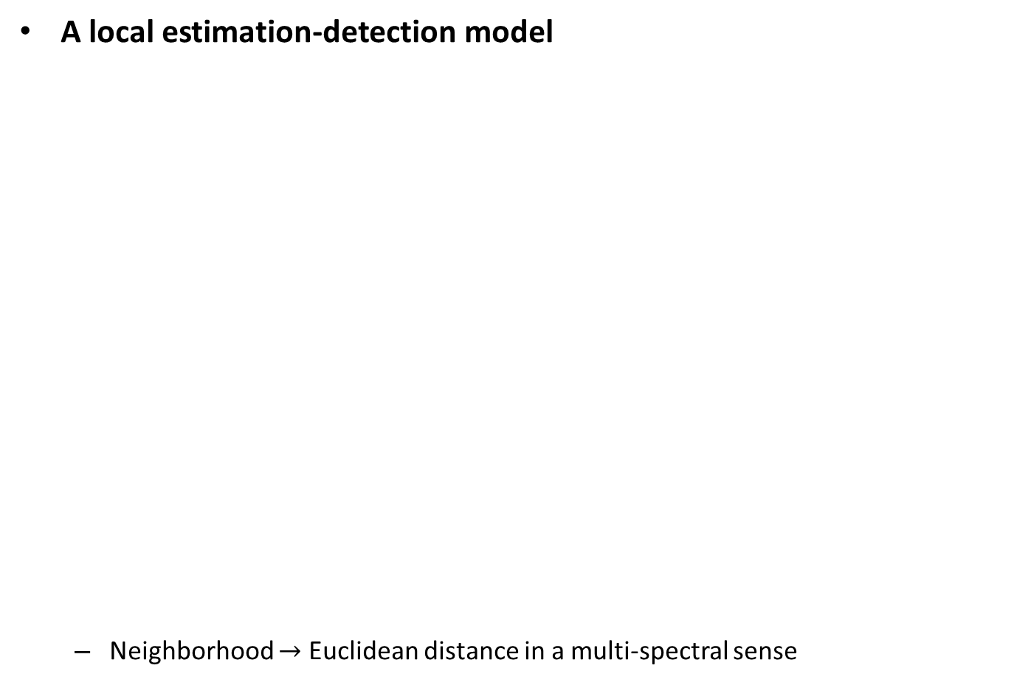
TMI rain/non-rain spectral signatures
A local estimation-detection model
  Neighborhood Euclidean distance in a multi-spectral sense
raining
raining
OCEAN
LAND
non-raining
non-raining

Slide 25
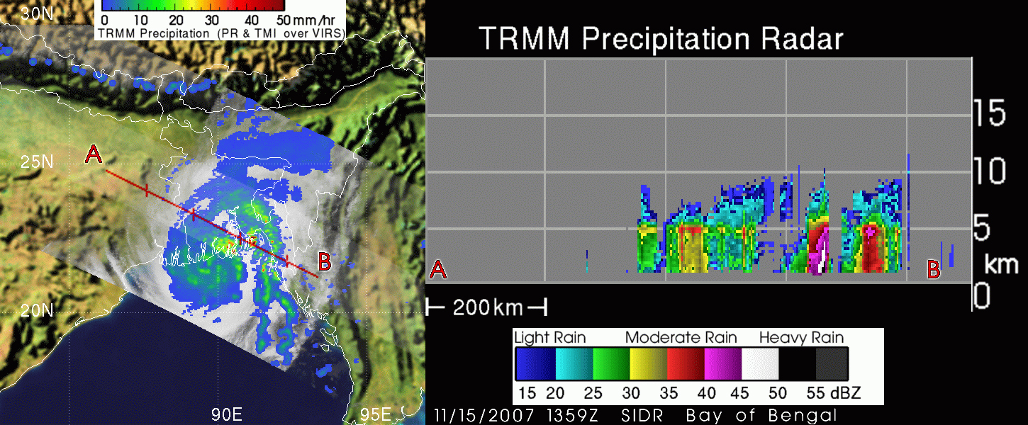
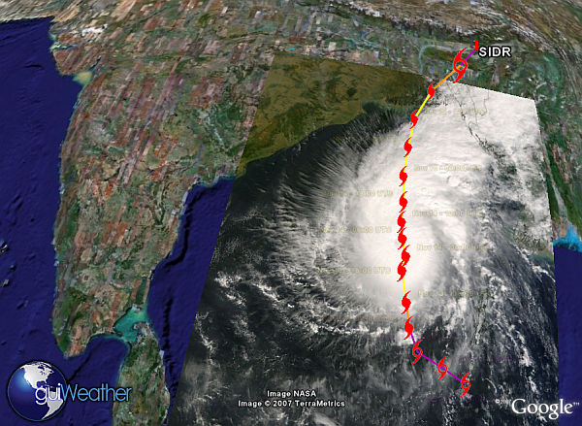
Cyclone Sidr, Nov. 2007
Date: Nov. 15 at 13:59 UTC (8:59 a.m. EST)

Slide 26
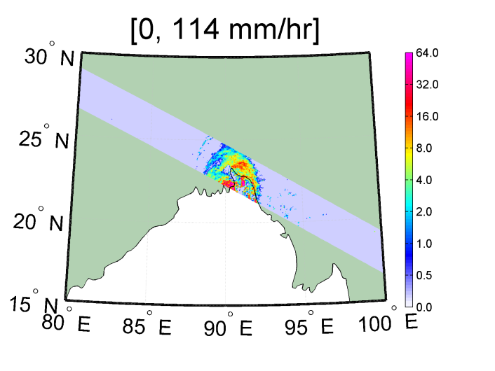


Retrieval of Tropical Cyclone Sidr
NASA GPROF -- 2A12-V7
Radar -- 2A25-V7
ShARP-V1

Slide 27

Retrieval of Monthly Rain, May 2013
NASA GPROF

Slide 28

Retrieval of Monthly Rain, May 2013

Slide 29

Retrieval of Monthly Rain, May 2013
Radar

Slide 30





ShARP retrieval uncertainty
  Hurricane Danielle (2010)
  Approximate the entire posterior PDF of the ShARP retrievals
  Probability of exceedance for the extreme rainfall for risk analysis

Slide 31


ShARP cumulative results
Difference of the total rainfall in calendar year 2013 (1º-degree)
NASA GPROF product - “true”
ShaRP retrieval – “true”

Slide 32



ShARP cumulative results
Rainfall accumulation thought January, February and March in calendar year 2013 (0.5º-degree)
Coastal zones
NASA
Passive retrieval
NASA
Active retrieval
(reference)
ShARP
Passive retrieval

Slide 33

Take home message and future research
GPM offers opportunities for accurate estimation of rainfall over coastal zones
The proposed ShARP algorithm introduces two innovations: (1) smart selection of estimation neighborhod and (2) advanced estimation within it (screens out irrelevant spectral candidates and reduces the effects of land surface heterogeneity in emissivity)
The superiority of the proposed algorithm, compared to the standard NASA retrieval algorithm especially over coastal areas, was demonstrated
Perform extensive testing over delta regions and examine improvement in retrieval, early warning systems, and modeling of inundation and floods
Co-authors: Mohammad Ebtehaj & Rafael Bras (Georgia Tech); Zach Tessler (CUNY)
Ebtehaj A.M., R. L. Bras, E. Foufoula-Georgiou (2014), Shrunken Locally Linear Embedding Algorithm for Retrieval of Precipitation http://arxiv.org/abs/1405.0454

