Slide 1
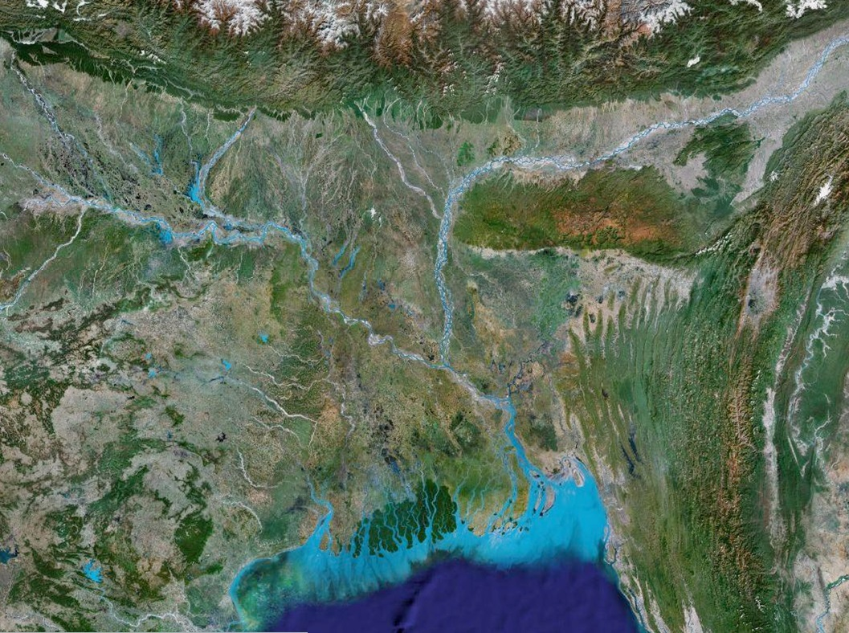



Constructing vulnerability maps of material and energy pathways in deltas
Deltas in Times of Climate Change II
Rotterdam. September 25, 2014
Efi Foufoula-Georgiou
University of Minnesota
Department of Civil, Environmental and Geo- Engineering

Slide 2
Discharge / Sediment
Local processes
Waves/Tides

Slide 3
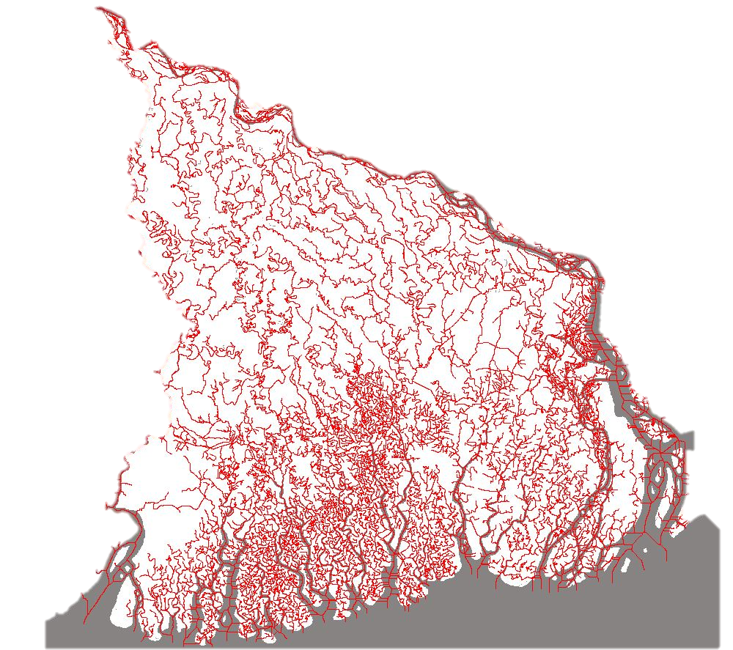
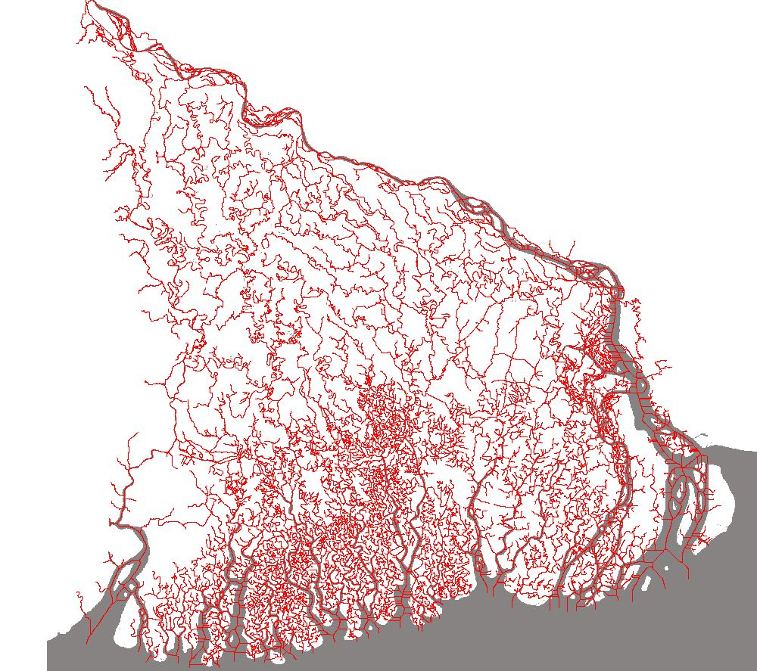
Network Courtesy of Paola Passalacqua

Slide 4


Questions
0
How does delta connectivity (in geometry and dynamics) control the overall system robustness to change?
Does connectivity of the delta tell us anything about the morphodynamics that established it?
Approach:
  Develop a framework that can allow probing into the delta system connectivity in a systematic way and evaluating system changes in view of changes in one or more of its connected components (vulnerability analysis)
We Propose:
  A rigorous framework of delta network analysis:
    Extracting subnetworks
    Nourishment Areas
    Upstream Areas
  Use this framework for building vulnerability maps
  Define metrics that capture the complexity of the topology and dynamics of the subnetworks, and enable us to establish a quantitative framework of comparison.

Slide 5
Deltas as Graphs
0
Graph
Representation
Algebraic
Representation
Physical Delta
1
  i= 1 2 3 4 5 6 7 8
2
7
  j= 1 2 3 4 5 6 7 8
3
4
8
6
5
Adjacency Matrix
Transport and Vulnerability in River Deltas: A Graph-Theoretic Approach
A Tejedor, A Longjas, I Zaliapin, E Foufoula-Georgiou
arXiv preprint arXiv:1408.5834

Slide 6
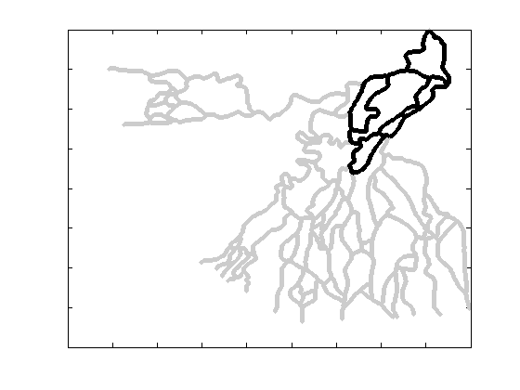
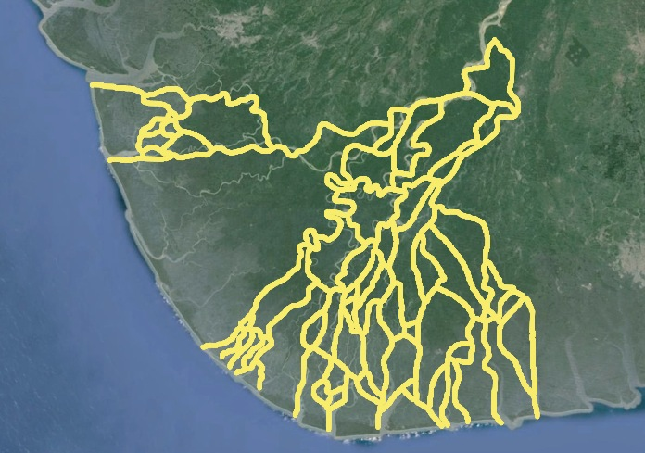
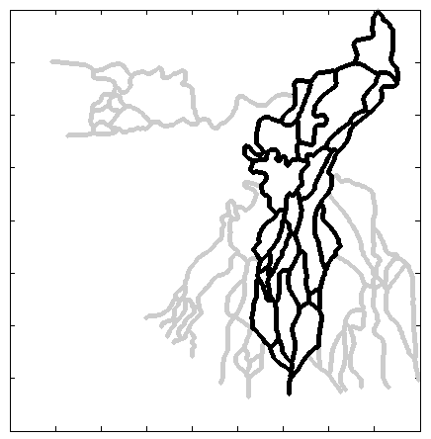
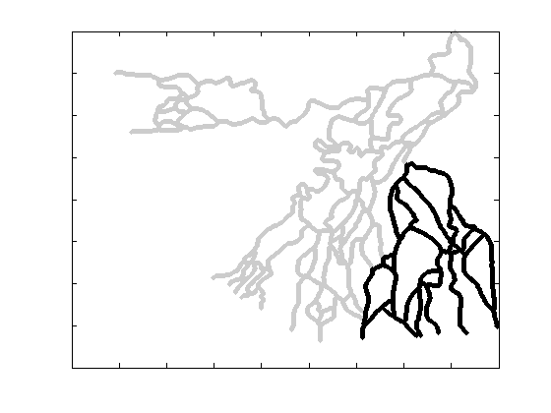
Delta Topologic Analysis
    Upstream Areas
From Adjacency Matrix:
    Extracting subnetworks
    Nourishment Areas

Slide 7
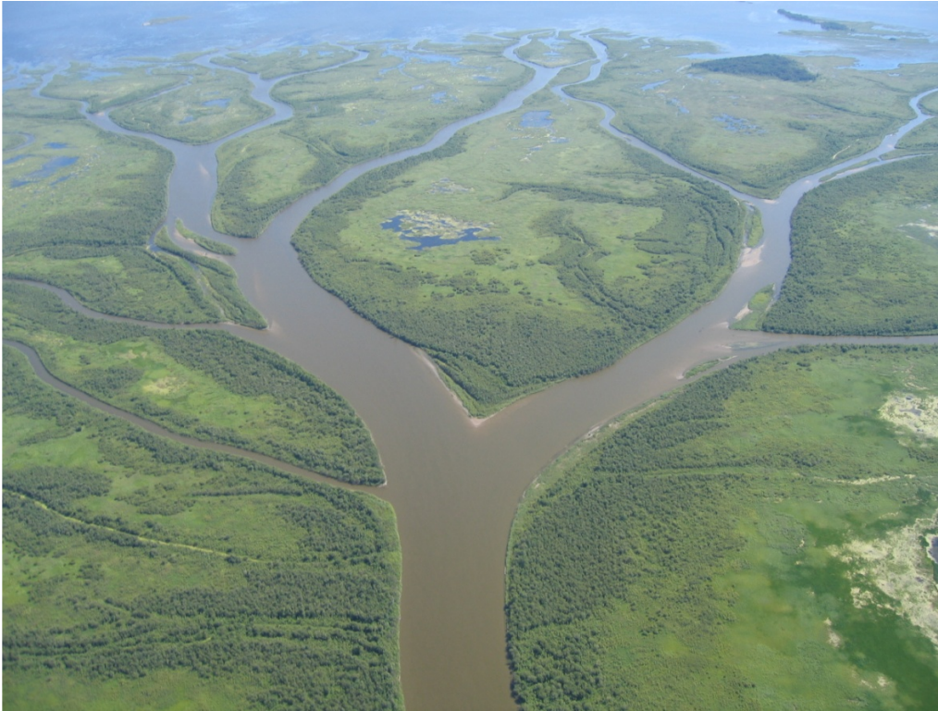
0

Slide 8
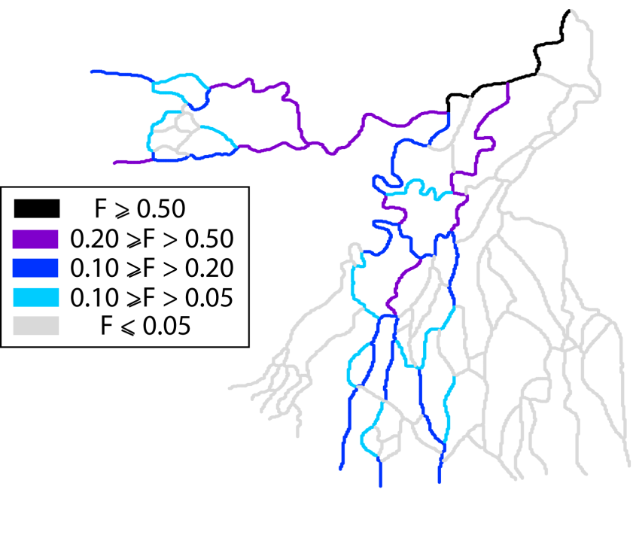
Delta Dynamic Analysis
0
From Weighted Adjacency Matrix:
    Steady Flux Distribution
Transport and Vulnerability in River Deltas: A Graph-Theoretic Approach
A Tejedor, A Longjas, I Zaliapin, E Foufoula-Georgiou
arXiv preprint arXiv:1408.5834

Slide 9
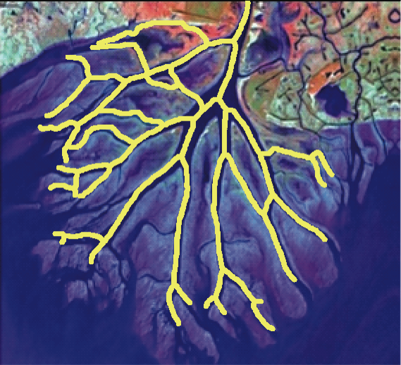
Vulnerability to change
0
How does a flux reduction at a given link affect the outlets?
What links (“hot spots”) cause the most drastic reduction to the outlets?
Wax Lake Delta
(Louisiana Coast, USA)
Niger Delta
(West Africa)

Slide 10
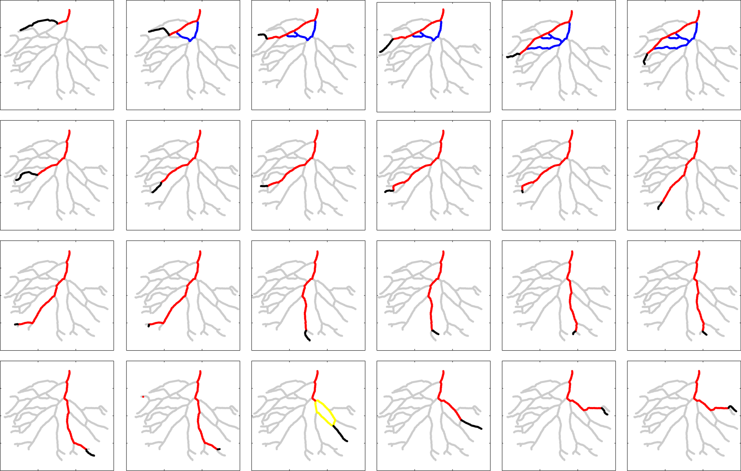
0
Vulnerability Maps
Wax Lake Delta
H
M
L

Slide 11
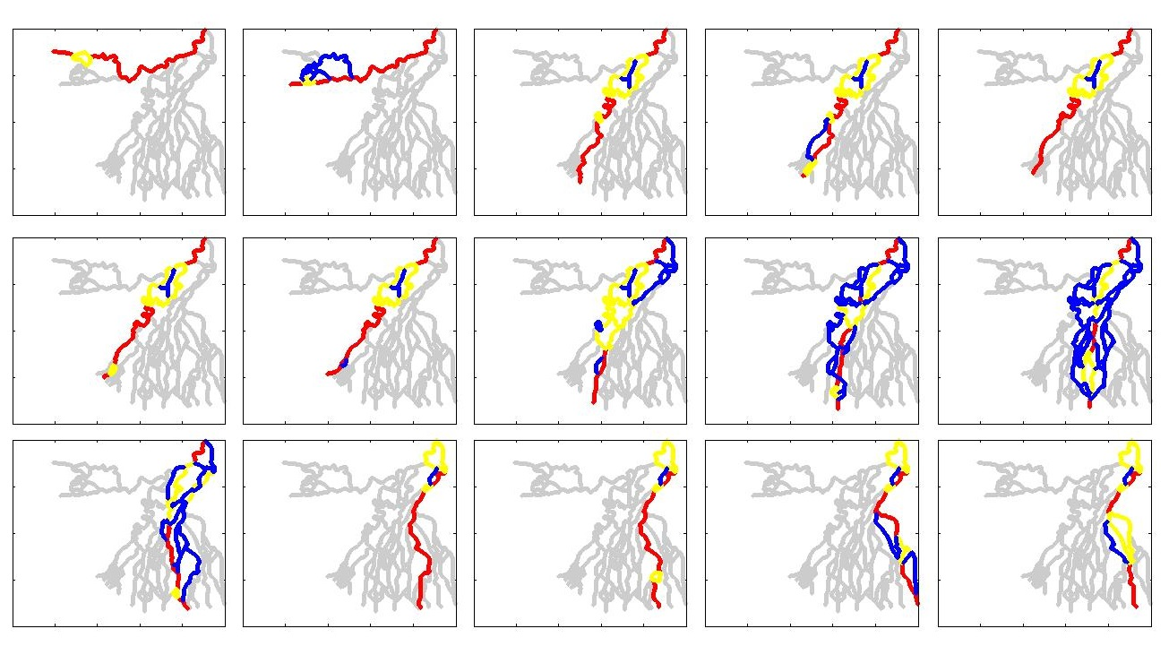
0
Vulnerability Maps
Niger Delta
H
M
L

Slide 12
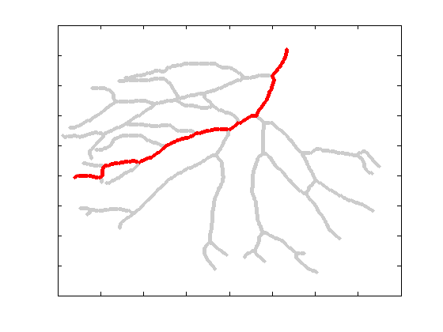
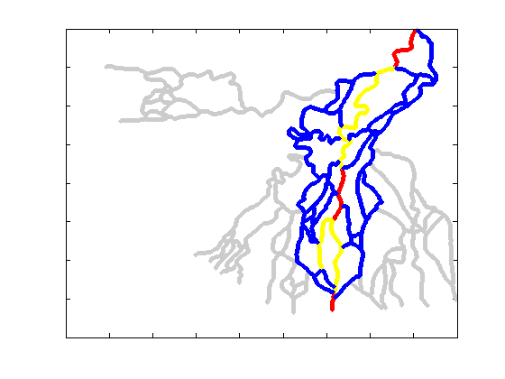
Process => Shape => Vulnerability?
0
Does vulnerability relate to the topology and dynamics of a deltas?
What metrics capture the topology and dynamics of deltas?
What does the topology and dynamics tell us about the physical processes that generated these deltas?

Slide 13
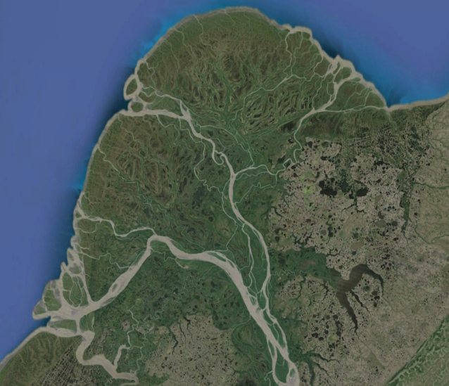
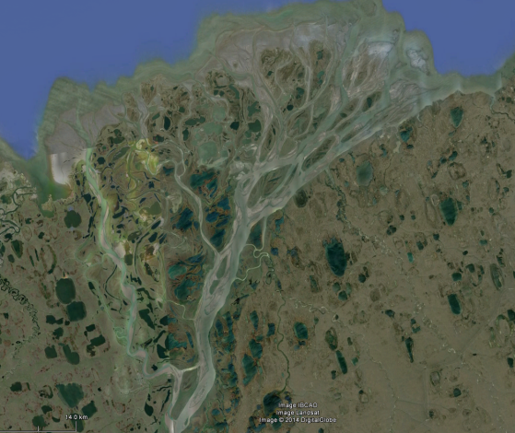
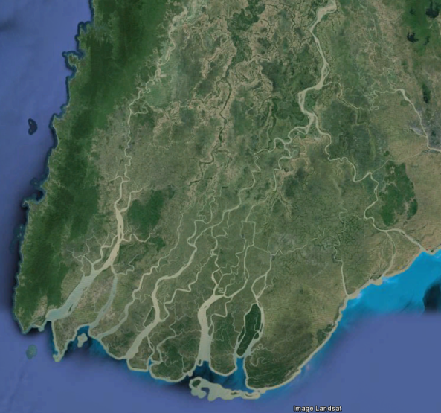
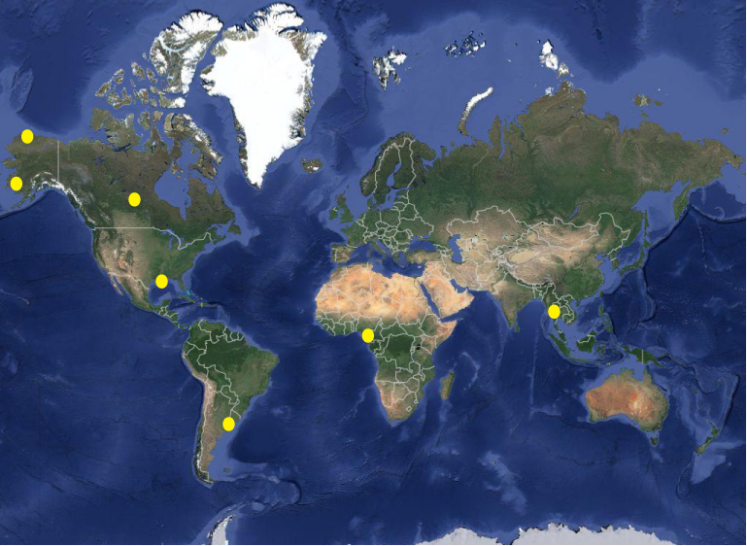
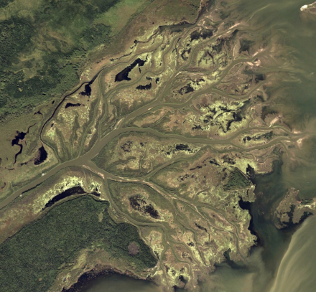
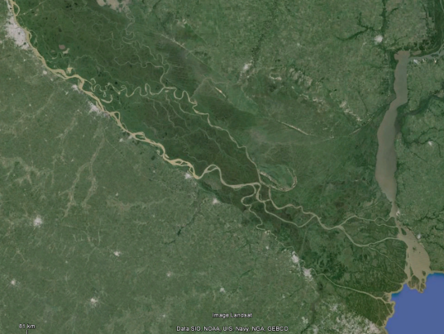
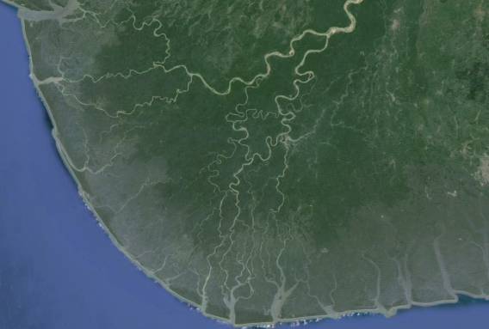
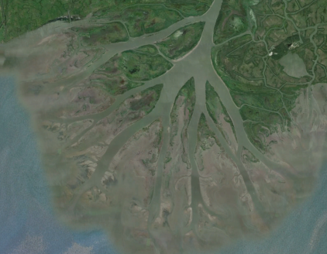
Yukon
Colville
Irrawaddy
Mossy
WaxLake
Parana
Niger

Slide 14
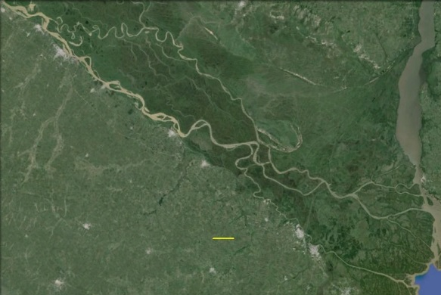
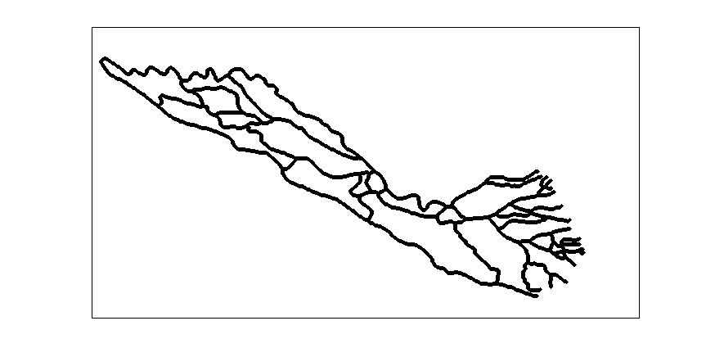
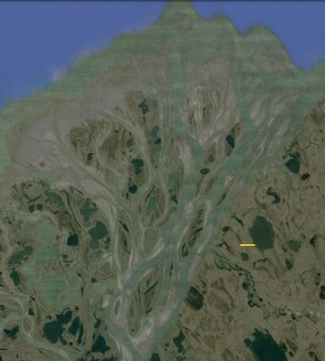
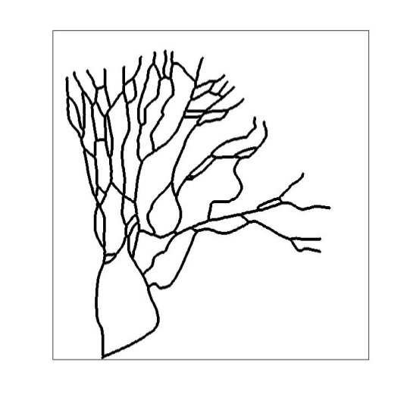
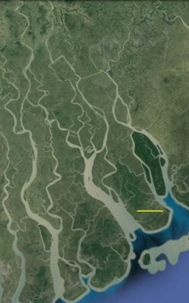
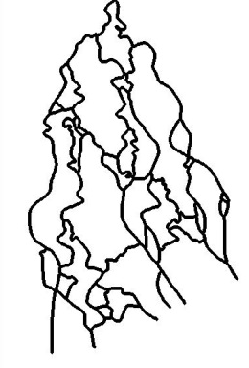
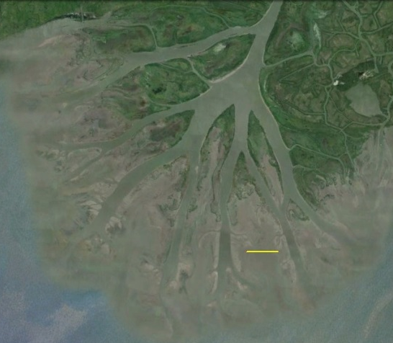
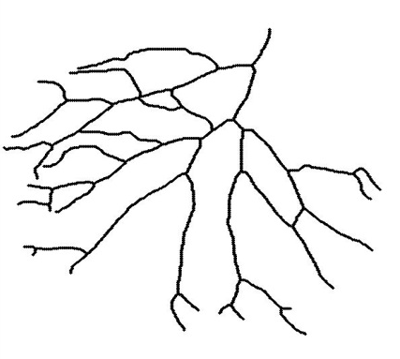
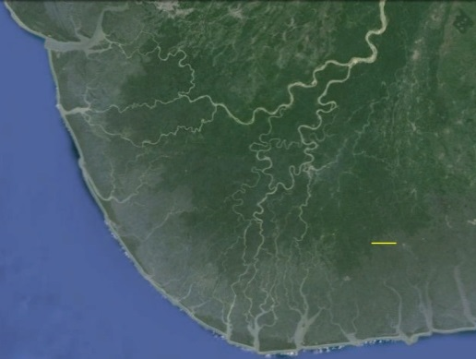
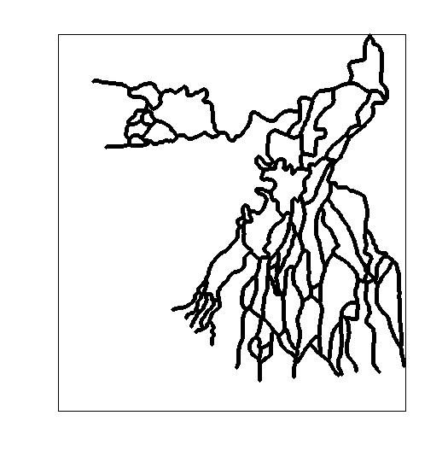
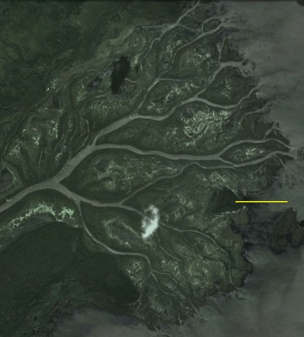
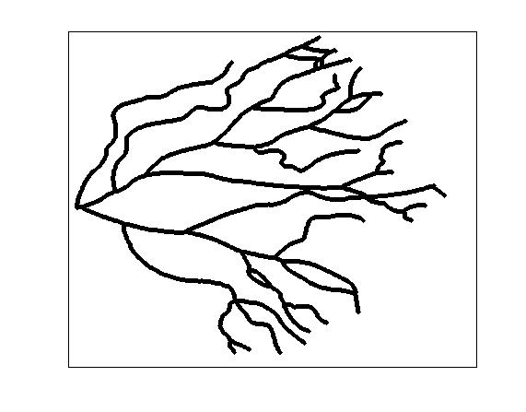
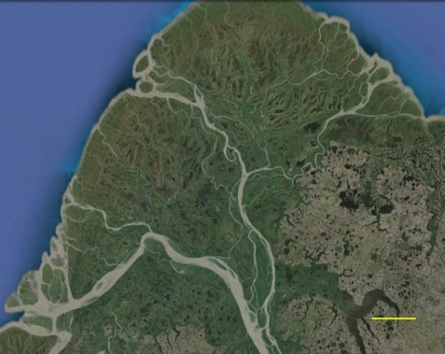
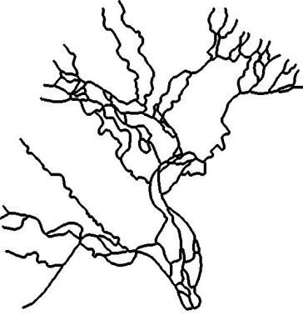
Parana
Colville
10 km
1 km
Irrawaddy
Wax Lake
10 km
Niger
1 km
Mossy
10 km
Yukon
1 km
10 km
(Smart and Moruzzi, 1972)

Slide 15
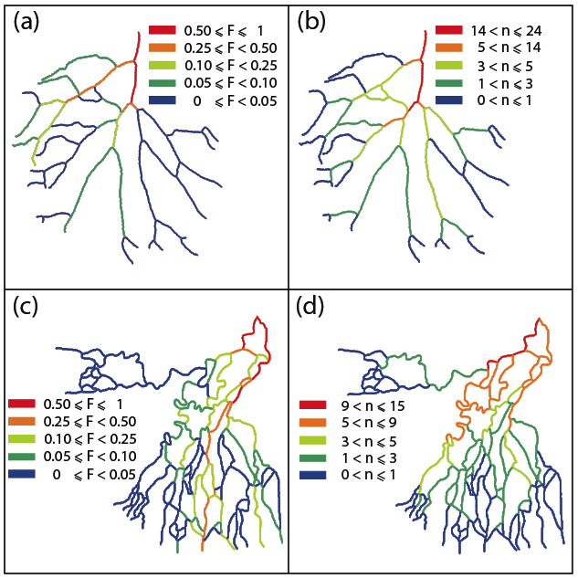
0
Geometric Complexity/Dynamic Exchange
1. Tree structure (Subnetworks are linear paths) versus loopy structure (Subnetworks contain multiple paths between the apex and the outlet)
2. How many Links (Flux) are shared among the different subnetworks. (Do some deltas consist of a set of pretty independent units/subnetworks, versus others that consist of a ‘core’ that is common to all the subnetworks?)
(n is the number of subnetworks to which a given link belongs)

Slide 16
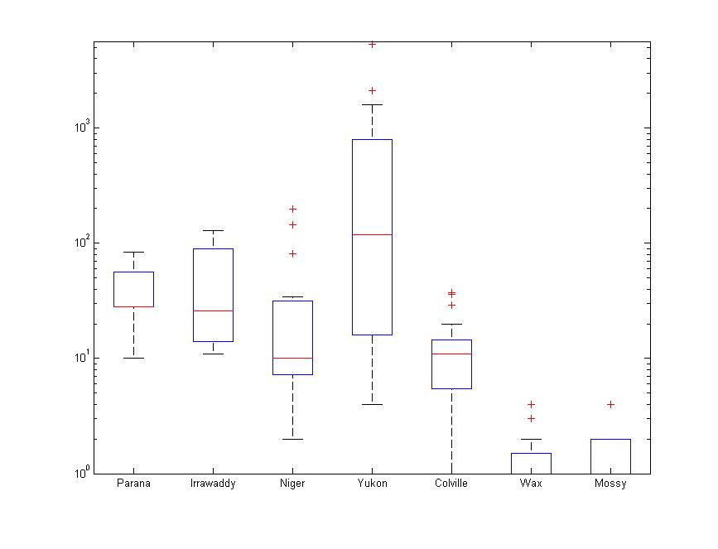





0
Geometric Complexity
Alternative Paths
Parana Irrawaddy Niger Yukon Colville Wax Lake Mossy

Slide 17
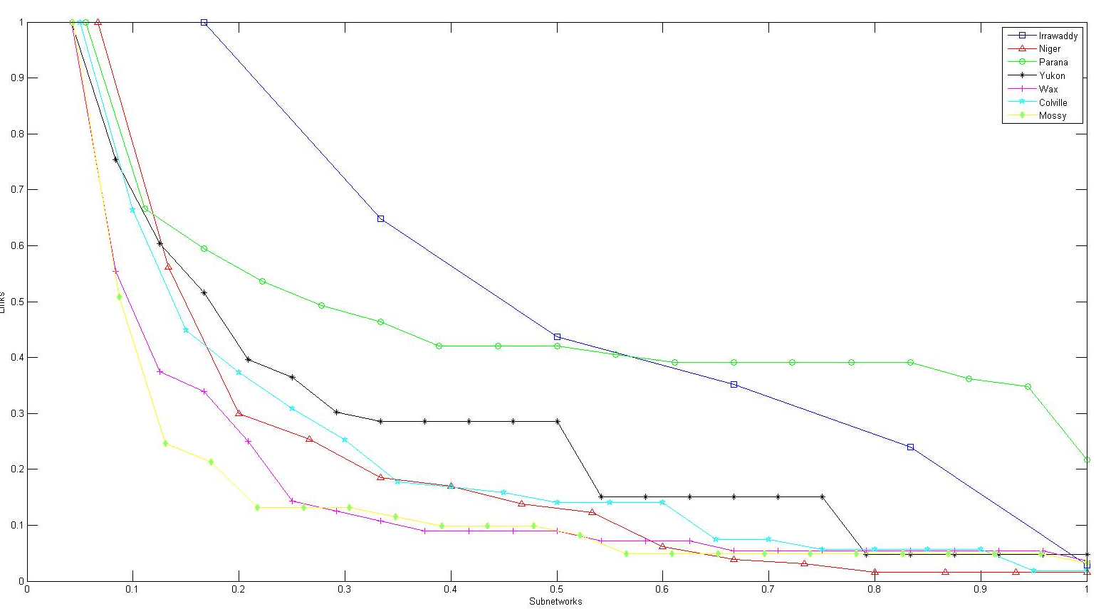
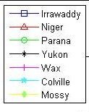
0
Differences from some deltas (or subnetworks) to others?
Sharing: Communal Space
Links
Subnetworks
Parana Irrawaddy Niger Yukon Colville Wax Lake Mossy

Slide 18
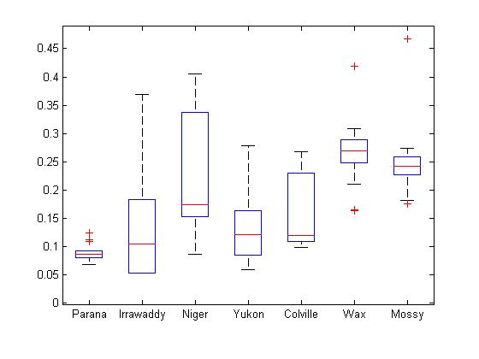
0
Dynamic Exchange
Leakage
Parana Irrawaddy Niger Yukon Colville Wax Lake Mossy

Slide 19
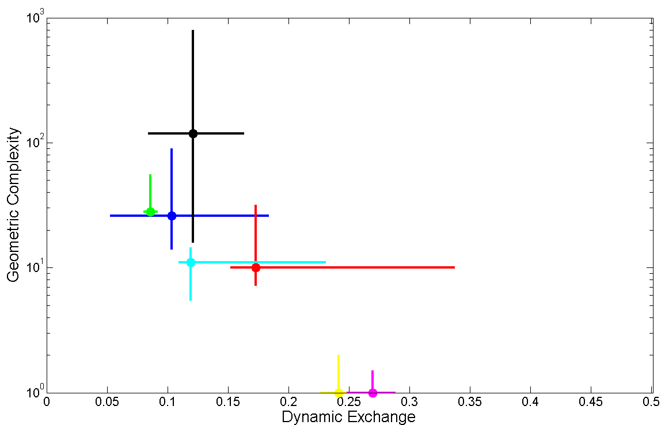
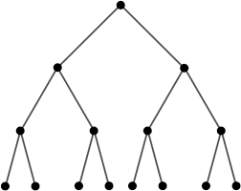
0
“2-D Geo-dynamic Space” for Deltas
Niger
Yukon
Irrawaddy
Geometric Complexity
Parana
Wax Lake
Dynamic Exchange
Colville
Mossy
Binary Tree

Slide 20
Open Problems
0
Do “physically similar” deltas fall close-by into this 2D Geo-dynamic space for deltas?
What does the “position” and “variability” in the 2D Geo-dynamic space reveal about the morphodynamic processes that created a delta?
Do deltas with substantial anthropogenic influences deviate from prestine deltas in the 2D Geo-dynamic space?
Can the age/size of a delta be revealed by its position into this 2D Geodynamic space?
How does this position relate to vulnerability to change?

Slide 21
Take home message
0
Deltas are networks of connected pathways that deliver fluxes from the apex to the deltaic surface to the coast.
This connectivity makes a difference in how vulnerable / robust they are to changes
We have presented a framework that allows us to efficiently study these systems as “graphs” in order to systematically:
    Compute the distribution of fluxes
    Define subnetworks
    Define Nourishment networks
    Define Contributing networks
    Evaluate scenarios of change
We have established quantitative metrics that account for topologic and dynamic characteristics of deltas.

Slide 22
Need automatic tools to extract delta networks from remotely sensed images
Network Courtesy of Paola Passalacqua

Slide 23
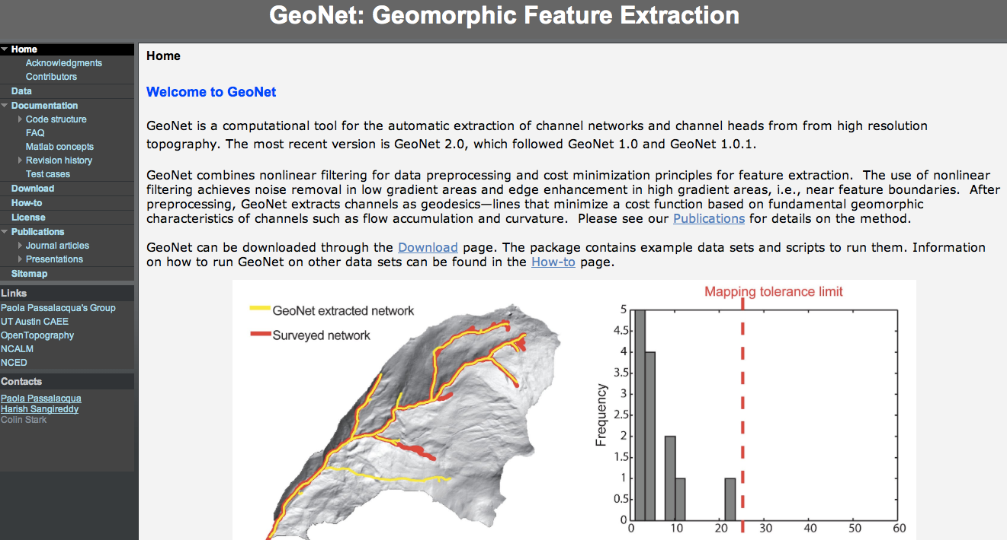

Slide 24






Thank you!
Alejandro Tejedor
University of Minnesota
Anthony Longjas
University of Minnesota
Ilya Zaliapan
University of Nevada, Reno
Irina Overeen
University of Colorado, Boulder
Fabrice Renaud
United Nations University
John Dearing
University of Southampton
Transport and Vulnerability in River Deltas: A Graph-Theoretic Approach
A Tejedor, A Longjas, I Zaliapin, E Foufoula-Georgiou arXiv preprint arXiv:1408.5834

